Slide 1
Network Intrusion Detection using Machine Learning
CAPSTONE PROJECT
Presented By:
Student name-Narmadha R
College name-Seshadripuram Degree College
Department-BCA

Slide 2
OUTLINE
Problem Statement
Proposed System/Solution
System Development Approach
Algorithm & Deployment
Result
Conclusion
Future Scope
References

Slide 3
Problem Statement
In today’s digital world, networks are vulnerable to various types of intrusions and cyber-attacks that threaten the integrity, confidentiality, and availability of data. Traditional intrusion detection systems often struggle to detect sophisticated or evolving attack patterns. Therefore, there is a need for an intelligent and automated system that can accurately classify network traffic as normal or malicious.
This project aims to develop a machine learning-based model for network intrusion detection. The model will be trained on a labeled dataset containing various network activity features and will learn to classify traffic as either "normal" or "attack". The goal is to enhance the speed, accuracy, and reliability of intrusion detection mechanisms.

Slide 4
Proposed Solution
To address the challenge of detecting network intrusions accurately and efficiently, the proposed solution involves the development of a machine learning-based Intrusion Detection System (IDS) using the following approach:
Dataset Preparation:
Generate or obtain a labeled dataset containing various features of network traffic.
Preprocess the data by handling missing values, encoding categorical variables, and normalizing features as needed.
Feature Selection:
Identify and select relevant features that contribute to detecting anomalies or attacks in network traffic.
Model Development:
Implement a Random Forest Classifier, a robust and widely-used ensemble machine learning algorithm.
Train the model to classify network activity as either normal or attack based on the selected features.
Model Evaluation:
Evaluate the performance of the model using metrics like accuracy, precision, recall, and F1-score.
Use test data to validate the model's generalization capabilities.
Intrusion Detection:
Deploy the trained model to monitor real-time or simulated network traffic and classify activities accordingly.
Raise alerts when malicious or abnormal behavior is detected.

Slide 5
System Approach
System requirements:
IBM Cloud
IBM Watson studio for model development and deployment
IBM cloud object storage for dataset handling

Slide 6
Algorithm & Deployment
Steps of Random Forest Algorithm:
Data Sampling:
Multiple random subsets (with replacement) are drawn from the original dataset — this is called bootstrap sampling.
Tree Construction:
For each sample, a decision tree is built.
At each node of the tree, only a random subset of features is considered for splitting.
Voting Mechanism:
Once all trees are built, each tree makes a prediction.
The majority vote among all trees is taken as the final prediction (for classification problems).
Prediction:
The trained forest can now classify new, unseen data accurately by leveraging its diverse trees.

Slide 7
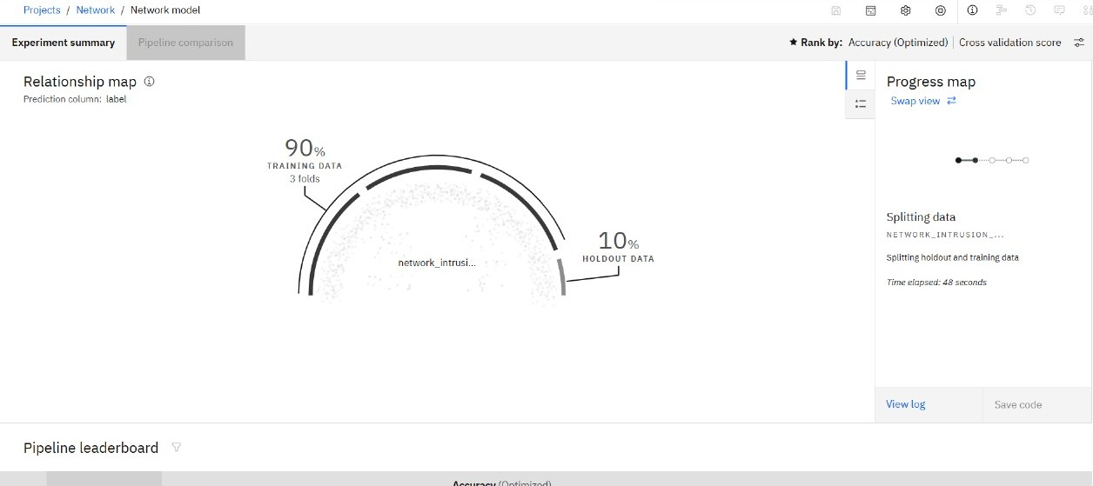
Result

Slide 8
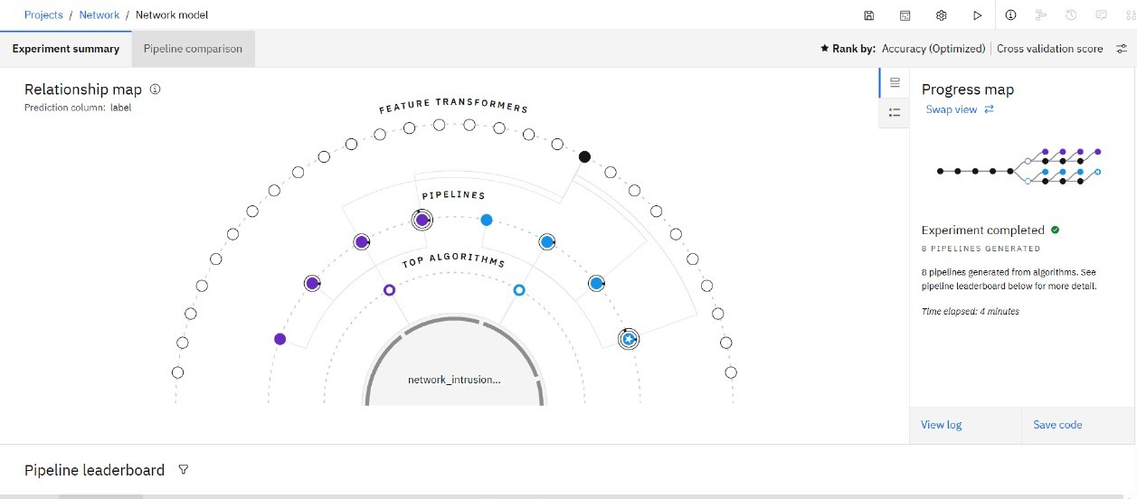

Slide 9
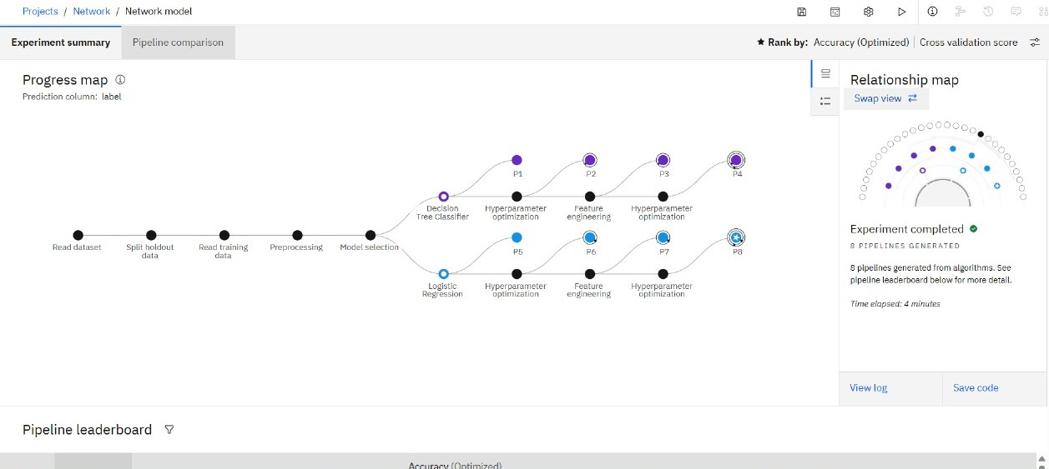

Slide 10
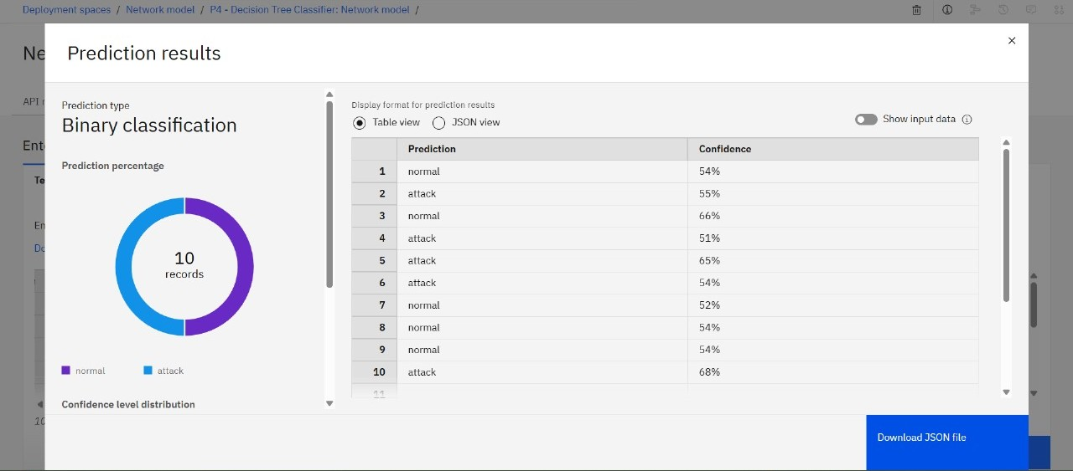

Slide 11
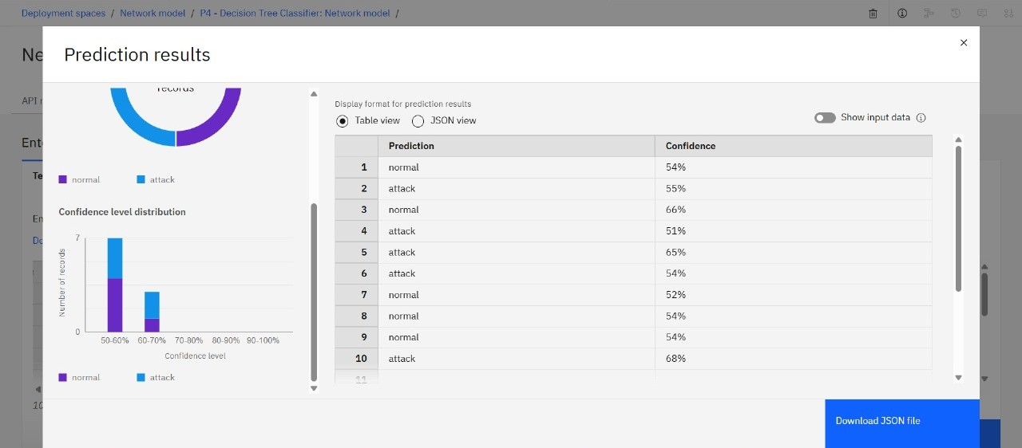

Slide 12
Conclusion
The project demonstrates the effectiveness of using the Random Forest algorithm for network intrusion detection. By training on labeled network traffic data, the model can accurately classify whether an activity is normal or malicious. This machine learning-based approach improves the accuracy, speed, and adaptability of intrusion detection compared to traditional methods.
It offers a scalable and automated solution for monitoring and protecting network systems. With further improvements like real-time detection, deep learning models, and continuous updates, the system can become even more robust and responsive to modern cyber threats.

Slide 13
Future scope
Real-Time Intrusion Detection Deploy the model to monitor live network traffic and detect threats instantly, improving response time.
Integration with Deep Learning Use advanced models like LSTM, CNN, or Autoencoders to detect complex and evolving attack patterns.
Online Learning Implement systems that continuously learn from new data to adapt to emerging cyber threats without retraining from scratch.
Multi-Class Classification Extend the system to classify different types of attacks (e.g., DoS, probe, R2L, U2R) instead of just normal vs. attack.
Cloud-Based Deployment Host the intrusion detection system on cloud platforms for scalable, remote, and distributed protection.
Visualization and Alerts Integrate dashboards for visualization of traffic and generate real-time alerts for security teams.

Slide 14
References
Leo Breiman,”Random Forest” Machine Learning Journal,2001
M.Tavallaee et al.,”Analysis of the KDD Cup 99 Dataset,”IEEE,2009
Wikipedia- Random Forest & Intrusion Detection System
Research papers and articles on Google scholar

Slide 15

IBM Certifications

Slide 16

IBM Certifications

Slide 17

IBM Certifications

Slide 18
THANK YOU

